Slide 1
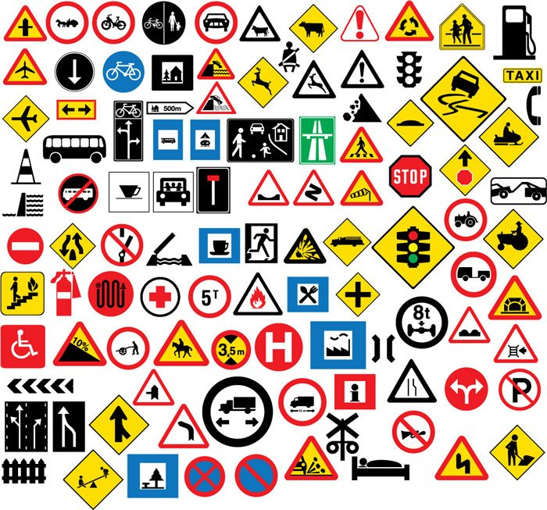
AI Project: Traffic Signs Recognition
Zhangchi Chen, Jieshuai Zhu, Wenhao Xu, Tianze Ren

Slide 2
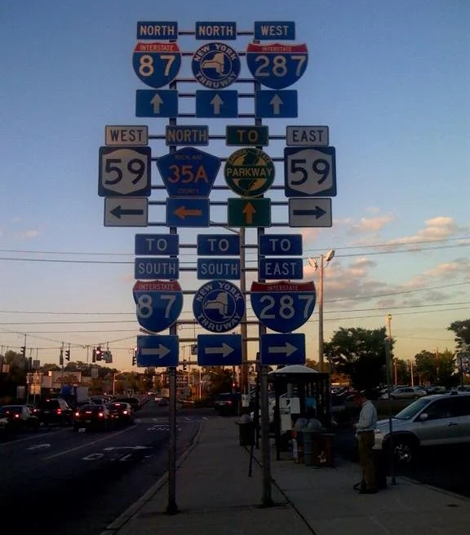
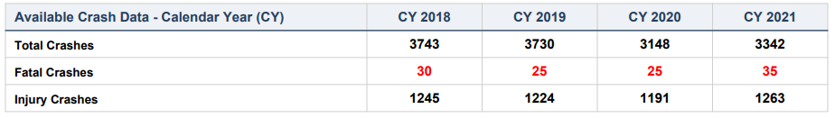
Background
Traffic Sign recognition is a critical part of contemporary transportation system, enhancing safety and facilitating traffic management.
Increasing ownership and prevalence has majorly increased the possibility of public traffic accidents. Some of them were probably caused by the untimely human reaction towards traffic signs, especially complicated ones.
With the advancement in technology, there might be a solution for this problem, which is autonomous driving system and it has a necessity to be able to recognize all these traffic signs.

Slide 3
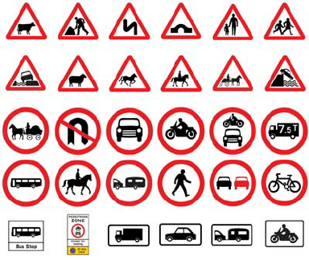
Introduction
In order to ensure the precisness and accuracy of autonomous driving system’s recognition technique, there is a need to recognize traffic signs in various situations, including fixed state, mobile state.
Our traffic sign visual recognitions system utilized machine learning algorithm to accurately detect and classify traffic signs from visual data such as video, pictures or cameras.
We will use this system and project to classify image and recognize our potential traffic sign objects and improve its accuracy which can probably be employed in the future fully autonomous driving system.

Slide 4


Dataset Overview: Key to Autonomous Navigation
The foundation of autonomous vehicle technology lies in its ability to recognize and interpret traffic signs in varying contexts and conditions.
Consists of diverse traffic sign images, suitable for a myriad of real-world scenarios.
Preprocessed for uniformity: standardized to 150x150 pixels, enabling consistent analysis.
This dataset underpins our model's learning, setting the stage for accurate real-time sign detection in autonomous systems.
Image Used in Dataset

Slide 5
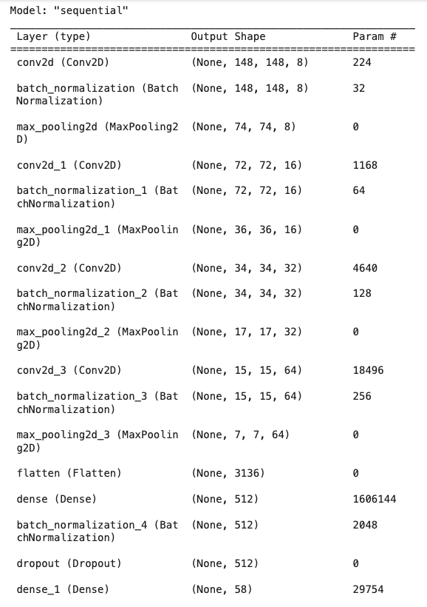
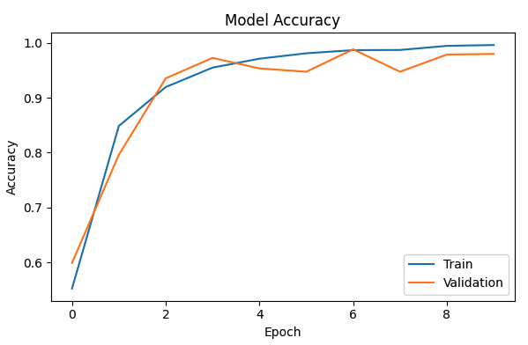
Self-made CNN Architecture
The first effort on classification includes a self-made CNN architecture by our group. It includes 4 sets of combination of convolution layer, batch normalization layer, and pooling layer. The dropout layer is added to avoid overfitting of individual image features. Then, a fully connected layer and denses layers are used to output 58 classes of images. A softmax activation function is applied to construct discrete classes with probabilities.
The performance on the validation set is not stable, containing potential problems of underfitting or overfitting.

Slide 6
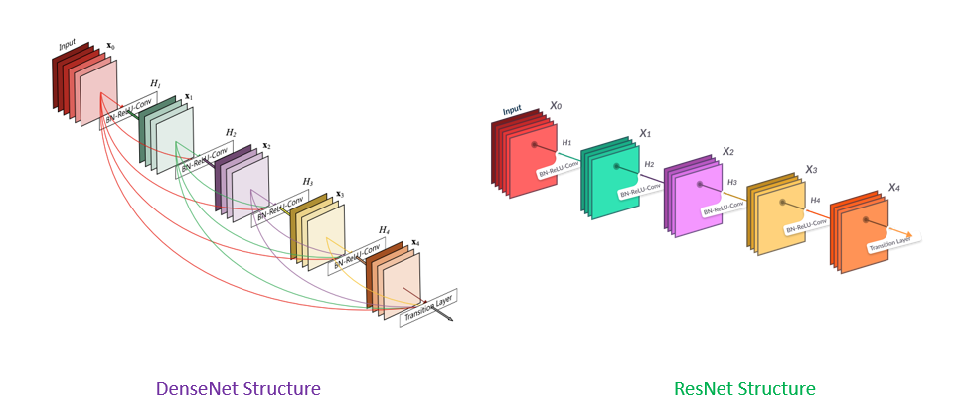
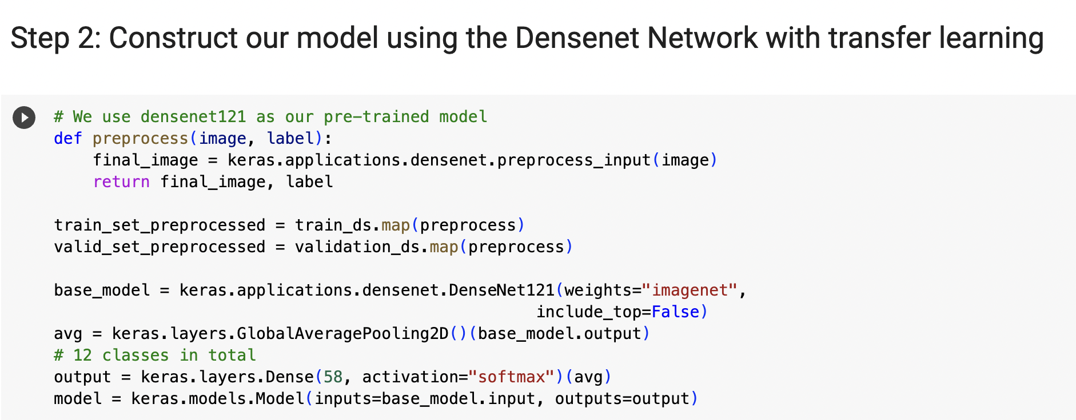
Densenet Algorithm Applied Through Transfer Learning
We leverage the sophistication of the Densenet architecture, renowned for its feature retention capabilities in image recognition tasks.
Enables the model to build on pre-established patterns and layers, accelerating the learning process and boosting performance.
Cuts down on computational overhead, streamlining the model training.
Tailored adjustments to Densenet cater to our specific dataset by training the top layer, refining the model for enhanced traffic sign recognition.

Slide 7
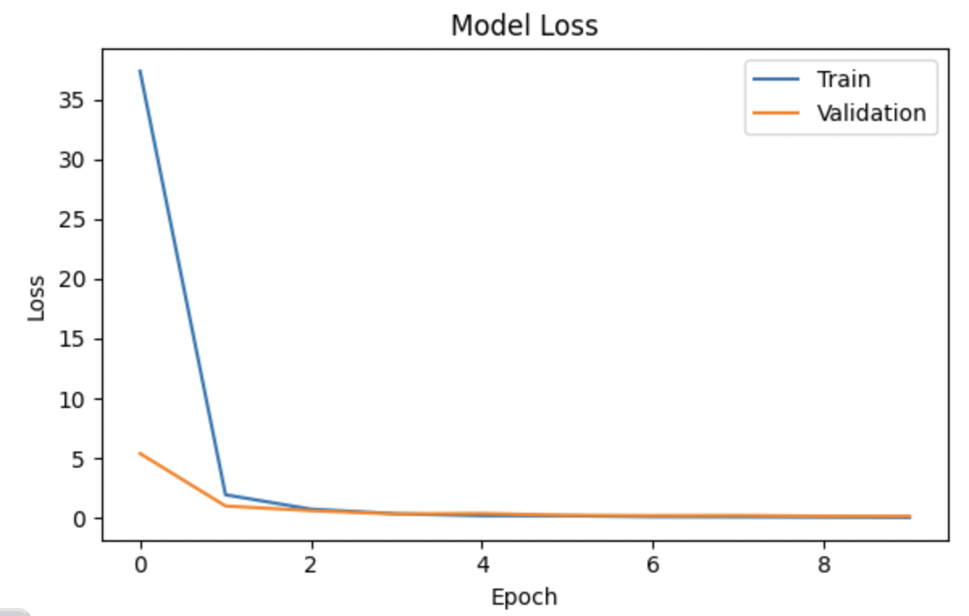
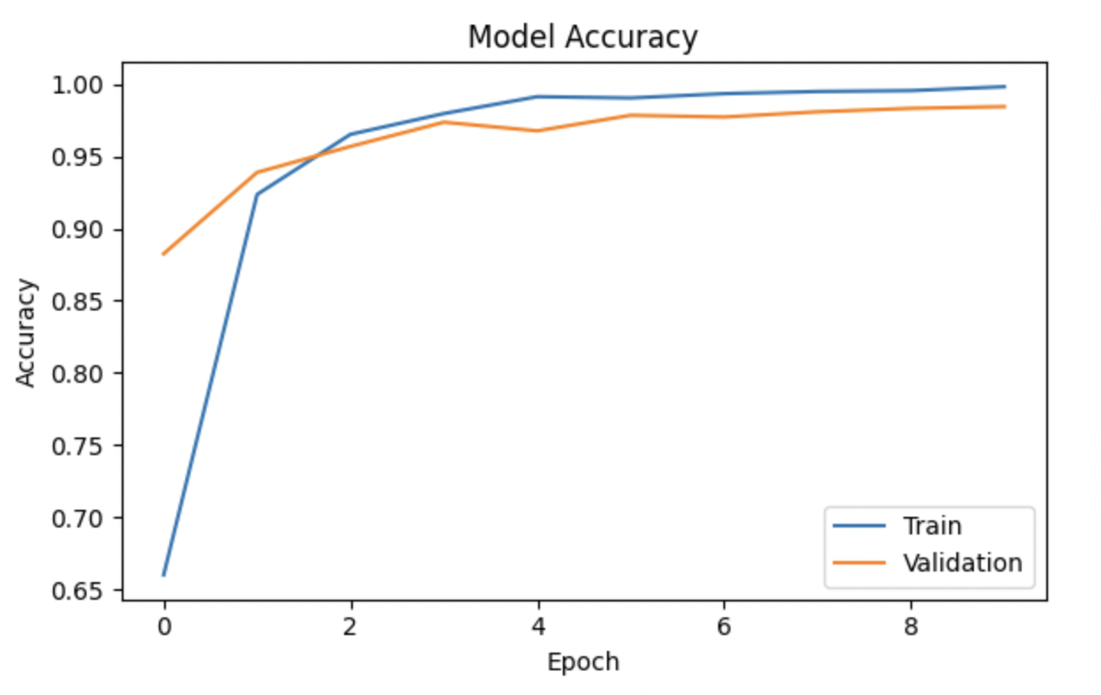
Advancements and Prospects: Navigating the Road Ahead
Our model has met our performance expectations, with accuracy metrics promising enhanced navigational support for autonomous vehicles.
Encountered and overcame unique challenges, including varying sign occlusions and lighting conditions.
Iterative improvements have led to a robust model capable of learning from dynamic traffic environments.
Future endeavors include deploying the model in simulated environments, advancing towards the ultimate goal of seamless integration into autonomous driving systems.

Slide 8


